Slide 1

Data Structures in Python

Slide 2

Agenda
Introduction to Graph and Terminology
Types of Graphs
Adjacency Matrix
Adjacency List
Breadth First Search (BFS)
Depth First Search (DFS)
Applications of BFS and DFS
Practice examples

Slide 3
Unit Overview
This unit introduces the Graph data structure, which is used to represent connections between different elements. Students will learn graph terminology, types of graphs, and different ways to represent graphs such as adjacency matrix and adjacency list.
The unit also covers graph traversal techniques, including Breadth First Search (BFS) and Depth First Search (DFS), which are used to explore and search graphs efficiently.
These concepts are important in real-world applications like social networks, maps, and network routing.

Slide 4
Introduction to Graph
A Graph is a data structure used to represent relationships between objects.
A graph consists of:
Vertices (Nodes) → represent objects
Edges → represent connections between vertices
Example:
A ---- B
| |
C ---- D
Vertices: A, B, C, D Edges: (A,B), (A,C), (B,D), (C,D)

Slide 5
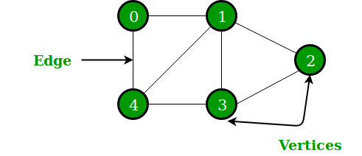
Graph Terminology
Vertex (Node)
A point in graph.
Example:
A, B, C
Edge
Connection between two vertices.
Example:
A — B

Slide 6
Graph Terminology
Cycle
Path that starts and ends at same vertex.
Example:
A → B → C → A
Degree
Number of edges connected to a vertex.
Example:
A connected to B and C
Degree of A = 2
Path
Sequence of vertices connected by edges.
Example:
A → B → D

Slide 7
Types of Graphs
1. Undirected Graph
Edges have no direction.
Example:
A — B
B — C
Connection works both ways.
2. Directed Graph (Digraph)
Edges have direction.
Example:
A → B
B → C
Only one direction allowed.

Slide 8
Types of Graphs
3. Weighted Graph
Edges have weights (cost, distance, time)
Example:
A —5— B
B —3— C
4. Unweighted Graph
Edges have no weights.
Example:
A — B

Slide 9
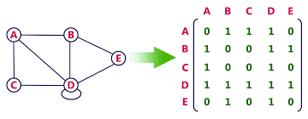
Graph Representation
Graphs can be represented in two ways:
Adjacency Matrix
Adjacency List

Slide 10
Adjacency Matrix
A 2D matrix used to represent graph connections.
Example Graph:
A — B
A — C
B — D
C — D
Python Example
graph = [
[0,1,1,0],
[1,0,0,1],
[1,0,0,1],
[0,1,1,0]
]
print(graph)

Slide 11
Adjacency List
Graph stored as list of connected vertices.
Example:
A → B, C
B → A, D
C → A, D
D → B, C
Python Example
graph = {
'A': ['B', 'C'],
'B': ['A', 'D'],
'C': ['A', 'D'],
'D': ['B', 'C']
}
print(graph)

Slide 12
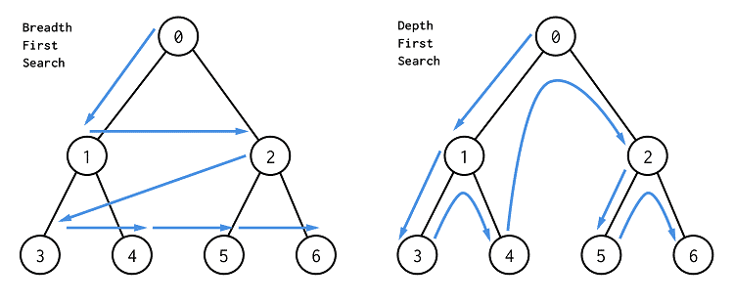
Breadth First Search (BFS)
BFS visits nodes level by level.
Uses Queue (FIFO)
Working Example
Graph:
A — B — D
|
C
Start from A
Visit order:
A → B → C → D

Slide 13
Breadth First Search (BFS)
Step-by-Step
Queue = [A]
Visit A Queue = [B, C]
Visit B Queue = [C, D]
Visit C Queue = [D]
Visit D
BFS Time Complexity
O(V + E)
V = vertices E = edges

Slide 14
Depth First Search (DFS)
DFS visits nodes depth by depth.
Uses Stack (LIFO) or Recursion
Working Example
Graph:
A — B — D
|
C
Visit order:
A → B → D → C

Slide 15
Depth First Search (DFS)
DFS visits nodes depth by depth.
Uses Stack (LIFO) or Recursion
Working Example
Graph:
A — B — D
|
C
Visit order:
A → B → D → C
DFS Time Complexity
O(V + E)

Slide 16
Real World Applications
Applications of DFS
Cycle detection
Maze solving
Topological sorting
Path finding
Example: Solving puzzles.
Applications of BFS
Shortest path in graph
Social network friend suggestions
GPS navigation
Web crawling
Example: Finding shortest path between cities.

Slide 17
Practice Example
Graph:
graph = {
'1': ['2','3'],
'2': ['4'],
'3': ['5'],
'4': [],
'5': []
}
BFS Output:
1 2 3 4 5
DFS Output:
1 2 4 3 5

Slide 18
Key Outcomes
Understand graph structure and terminology
Identify different types of graphs
Represent graphs using adjacency matrix and adjacency list
Implement BFS and DFS in Python
Understand graph traversal techniques
Apply graphs in real-world problems

Slide 19
Thank You!

